Slide 1
DevOps with TFS

Slide 2
Topics Covered
Introducing DevOps
Visual Studio
What is DevOps?
Agile Vs DevOps
DevOps Lifecycle
Tools for Adopting DevOps
Microsoft DevOps Solution
Consolidation using Version Control
Why Version Control?
Version Control in TFS
Team Projects & Team Project Collections
TFVC Overview
Get + TFS Overview
Get or TFVC

Slide 3
Visual Studio
Visual Studio is an Integrated Development Environment(IDE) developed by Microsoft to develop GUI(Graphical User Interface), console, Web applications, web apps, mobile apps, cloud, and web services, etc.
It uses various platforms of Microsoft software development software like Windows store, Microsoft Silverlight, and Windows API, etc.
Notes:
It is not a language-specific IDE as you can use this to write code in C#, C++, VB(Visual Basic), Python, JavaScript, and many more languages. It is available for Windows as well as for macOS.
Visual Studio supports 36 different programming languages and allows the code editor and debugger to support (to varying degrees) nearly any programming language, provided a language-specific service exists. Built-in languages include C,^{[7]} C++, C++/CLI, Visual Basic .NET, C#, F#,^{[8]} JavaScript, TypeScript, XML, XSLT, HTML, and CSS. Support for other languages such as Python,^{[9]} Ruby, Node.js, and M among others is available via plug-ins. Java (and J#) were supported in the past.

Slide 4
Evolution of Visual Studio
Visual Studio Editions
There are 3 editions of Microsoft Visual Studio as follows
Community
Professional
Enterprise
Notes:
*The first version of VS(Visual Studio) was released in 1997, named as Visual Studio 97 having version number 5.0.
*Latest version available 2019 - version 16.2.5 (September 10, 2019)
Community: It is a free version which is announced in 2014. All other editions are paid. This contains the features similar to Professional edition. Using this edition, any individual developer can develop their own free or paid apps like .Net applications, Web applications and many more. Its main purpose is to provide the Ecosystem(Access to thousands of extensions) and Languages(You can code in C#, VB, F#, C++, HTML, JavaScript, Python, etc.) support.
Professional: It is the commercial edition of Visual Studio. It comes in Visual Studio 2010 and later versions. It provides the support for XML and XSLT editing and includes the tool like Server Explorer and integration with Microsoft SQL Server. Its main purpose is to provide Flexibility(Professional developer tools for building any application type), Productivity(Powerful features such as CodeLens improve your team’s productivity), Collaboration(Agile project planning tools, charts, etc.) and Subscriber benefits like Microsoft software, plus Azure, Pluralsight, etc.
Enterprise: It is an integrated, end to end solution for teams of any size with the demanding quality and scale needs. The main benefit of this edition is that it is highly scalable and deliver high-quality software.

Slide 5
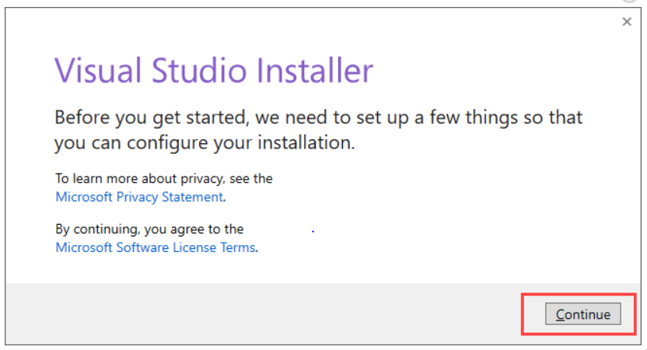
What you can do?
Develop, Analyze, Debug, Test, Collaborate & Deploy
Download and Installation
Download the VS exe file of your required version
In the next screen, click continue

Slide 6
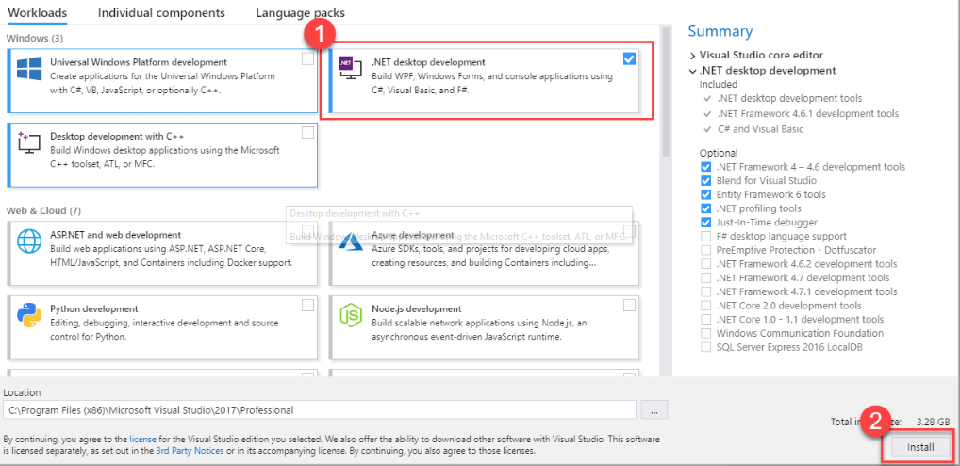
Visual Studio will start downloading the initial files.
Once downloaded, click on Install
In next screen, select required options & click install. Visual Studio will download the relevant files based on your selection

Slide 7
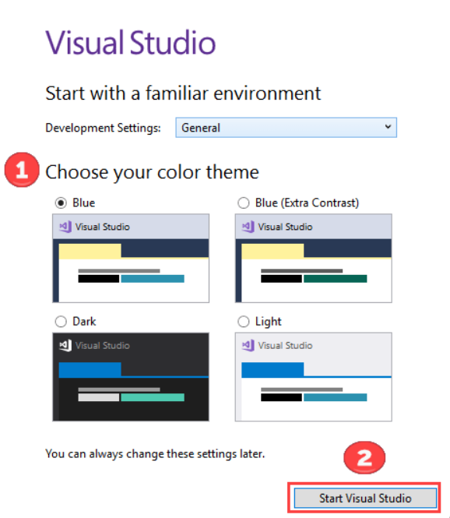
Once the installation is done, reboot the PC.
Post reboot, open the Visual Studio IDE, set the theme and click start
You are ready to go

Slide 8
IDE stands for?
a) Integrated Distributed Environment
b) Integrated Development Environment
c) Installation Development Environment
d) Integrated Development Evolution

Slide 9
IDE stands for?
a) Integrated Distributed Environment
b) Integrated Development Environment
c) Installation Development Environment
d) Integrated Development Evolution

Slide 10
What is DevOps?
DevOps is considered a practice of bringing development and operations teams together, thus focusing on constant testing and delivery.
Purpose - DevOps central concept is to manage end-to-end engineering processes.
Tools used - Puppet, Chef, TeamCity OpenStack, AWS are popular DevOps tools.
Notes:
While DevOps is not a technology, but there are tools used commonly in DevOps environments. These include continuous integration and continuous delivery or continuous deployment tools, with an emphasis on task automation. Other products to support DevOps include real-time monitoring and incident response systems, as well as collaboration platforms.
A DevOps approach can coexist with Agile software development IT service management frameworks, such as IT Infrastructure Library project management directives, such as lean and six sigma and other strategies to execute IT projects to meet business needs. While it is typically associated with Agile development, the two methodologies do not need to be used in concert.

Slide 11
Agile
Agile refers to an iterative approach which provides full visibility into your software development process through shorter release cycles
Purpose - Agile helps to manage complex projects.
Tools used - JIRA, Bugzilla, Kanboard are some popular Agile tools.
Notes:
Agile is a software development approach focused on incremental and rapid cycles of code creation and delivery, referred to as sprints . Each sprint iterates upon the last, which creates a high level of flexibility; IT administrators can evaluate more easily the changes, scope and direction between each cycle. However, it is possible for the original vision of a project to be lost through this cycle.

Slide 12
Any code commit that passes the automated testing phase is automatically released into the production environment is called?
a) Continuous Integration
b) Component Integration
c) Continuous Deployment
d) Computer Deployment

Slide 13
Any code commit that passes the automated testing phase is automatically released into the production environment is called?
a) Continuous Integration
b) Component Integration
c) Continuous Deployment
d) Computer Deployment

Slide 14
Which of the following is not an agile process?
a) Planning
b) Requirement analysing
c) Designing
d) Releasing

Slide 15
Which of the following is not an agile process?
a) Planning
b) Requirement analysing
c) Designing
d) Releasing

Slide 16
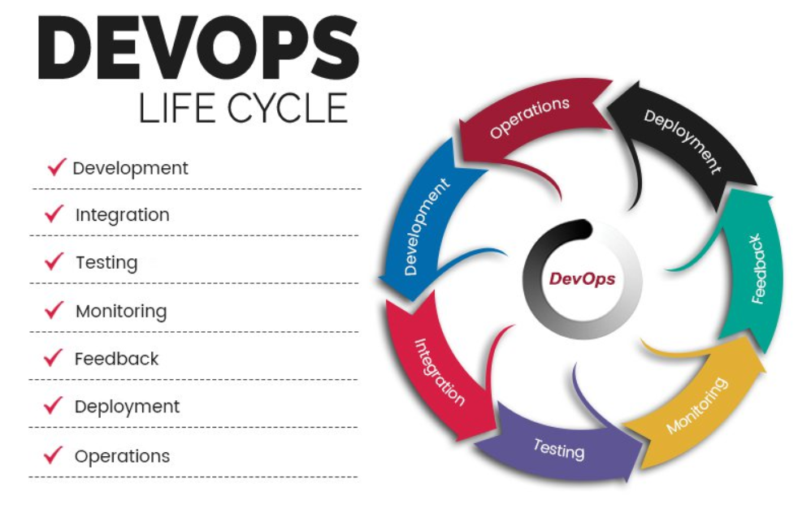
Notes:
1). Continuous Development
(Plan application objectives and Code the requirements)
2). Continuous Integration
(Plan Tests and Build the product)
3). Continuous Testing
(Verify the product for actual usage in a live environment)
4). Continuous Monitoring
(Monitor the product output and find the problem areas)
5). Continuous Feedback
(Improvise the current product and helps to release new versions quickly)
6). Continuous Deployment
(Ensures product is deployed with maximum accuracy)
7). Continuous operations
(Automate release process with shorter development cycles)

Slide 17
Which phase is the operational phase in Devops lifecycle?
a) Continuous Testing
b) Continuous Monitoring
c) Continuous Feedback
d) Continuous Operations

Slide 18
Which phase is the operational phase in Devops lifecycle?
a) Continuous Testing
b) Continuous Monitoring
c) Continuous Feedback
d) Continuous Operations

Slide 19
DevOps Solution
DevOps practices include continuous integration and continuous delivery (CI/CD), infrastructure as code, and continuous monitoring with Azure and the DevOps toolchain of your choice.
Notes:
From code to cloud, automate each part of the DevOps process with continuous integration and continuous delivery and your choice of tooling:
Define a CI/CD pipeline and manage releases with multiple environments using Azure Pipelines.
Target any service on Azure including Azure Kubernetes Service (AKS), Azure Virtual Machines or Azure Functions.
Automate workflows with GitHub Actions.
Host Jenkins workloads, extend existing configuration or simplify CI/CD with Jenkins plug-ins for Azure.
Create fast and repeatable deployments into Azure with Spinnaker.

Slide 20
Version Control
A version control system allows users to keep track of the changes in software development projects, and enable them to collaborate on those projects. Using it, the developers can work together on code and separate their tasks through branches.
Notes:
A version control software saves all the changes in a repository. Hence, if the developers make a mistake, they can undo it. At the same time, they can compare the new code with a previous version(s) to resolve their grievance. This can reduce human errors and unintended consequences to a great extent. A great fit for any web development company around the globe.
Additionally, it can be integrated with several software development tools like PaaS providers, integrated development environments (IDE) and build automation tools.

Slide 21
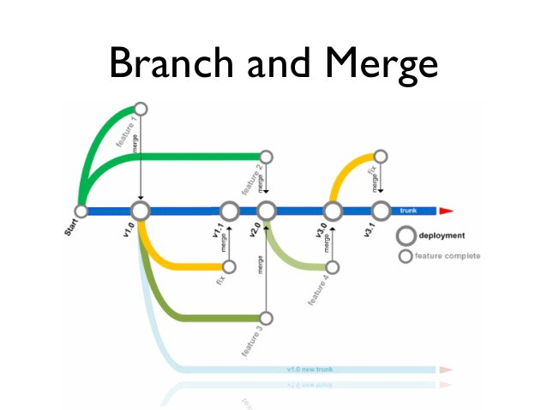

Slide 22
Version Control in TFS
Developed by Microsoft, the Team Foundation Server is an enterprise-grade tool to manage source code and other services that need versioning. It can keep track of work items to find defects, requirements, and scenarios in a project.
It comes with several unique features like Team Build, data collection and reporting, Team Project Portal, Team Foundation Shared Services, etc.
Notes:
There can be several branches in a version control system, according to the number of collaborators. The branches maintain individuality as the code changes remain in a specified branch(s).
Developers can combine the code changes when required. Further, they can view the history of changes, go back to the previous version(s) and use/manage code in the desired fashion.

Slide 23
TFVC Overview
TFVC is a democratized approach that enables the software development process to easily adopt robust tools and best practices without cost and complexity as key inhibitors.
Building the TFS project requires identifying and fleshing out all work items, which TFS will push out to all related systems.
Notes:
Microsoft TFS not only automates the workflow, it guides the software development process in a more streamlined way.
TFS also uniquely collects real-time data intelligence based on project history, differing from the approaches that rely on industry benchmark data.
TFS serves as a data warehouse that critically links the various roles in the software development lifecycle – from the individual developer to the architect, testers, system administrators, and all the way to the CIO and Project Management Office, This helps in capacity planning, resource management, and impact and risk analysis. So that the right software projects may be selected for the best Return on Investment (ROI).
TFS tackles the problem of having to constantly update outdated information, thereby ensuring that collaboration which is particularly important in outsourcing or distributed development scenarios.
A good example of this is, the professional developer and the creative professional (designer) they need to come together and work collaboratively to build the next generation of differentiated user experiences.

Slide 24
GIT Overview
GitHub helps software teams to collaborate and maintain the entire history of code changes. You can track changes in code, turn back the clock to undo errors and share your efforts with other team members.
It is an open source version control system that features local branching, multiple workflows, and convenient staging areas. Git version control is an easy to learn option and offers faster operation speed.
Notes:
On a very basic level, there are two awesome things a VCS allows you to do: You can track changes in your files, and it simplifies working on files and projects with multiple people. There are multiple Version Control Systems, but Git is by far and large the most popular — both for individual and company use.
On the other hand, GitHub is a web based Git repository. It provides a free and easy place to use Git, the cloud to store your code in, and it allows you to interact with other developers on Open Source projects.

Slide 25
GIT vs TFVC
Git is a distributed version control system. Each developer has a copy of the source repository on their dev machine.
Team Foundation Version Control (TFVC) is a centralized version control system. Typically, team members have only one version of each file on their dev machines. Historical data is maintained only on the server. Branches are path-based and created on the server.
Notes:
In Git,
Developers can commit each set of changes on their dev machine and perform version control operations such as history and compare without a network connection. Branches are lightweight. When you need to switch contexts, you can create a private local branch. You can quickly switch from one branch to another to pivot among different variations of your codebase. Later, you can merge, publish, or dispose of the branch.
TFVC has two workflow models:
Server workspaces - Before making changes, team members publicly check out files. Most operations require developers to be connected to the server. This system facilitates locking workflows. Other systems that work this way include Visual Source Safe, Perforce, and CVS. With server workspaces, you can scale up to very large codebases with millions of files per branch and large binary files.
Local workspaces - Each team member takes a copy of the latest version of the codebase with them and works offline as needed. Developers check in their changes and resolve conflicts as necessary. Another system that works this way is Subversion.

Slide 26
GIT or TFVS
Git is the default version control provider for new projects. You should use Git for version control in your projects unless you have a specific need for centralized version control features in TFVC.
You can use TFVC repos with Git in the same Project so it's easy to add TFVC later if you need centralized version control. To setup a new repo type for an existing project

Slide 27
In Which version control can file history be replicated to dev machine?
a) TFVC
b) GIT
C) Both
d) Neither

Slide 28
In Which version control can file history be replicated to dev machine?
a) TFVC
b) GIT
C) Both
d) Neither

